Slide 1
Evolution of brain and body
Group 6B
Iulia-Alexandra Lungu, Enrique Fernández Rodicio, Mathias Schmerling

Slide 2
Outline
Motivation
Software considered
Robogen
Brain evolution
chasing scenario
racing scenario
Body-brain coevolution, racing scenario
Body-brain coevolution, chasing scenario

Slide 3
Motivation
biologically realistic
outsourcing computation to morphology/environment
reducing designer bias
emergence of interesting features
better body-environment-controller compatibility

Slide 4
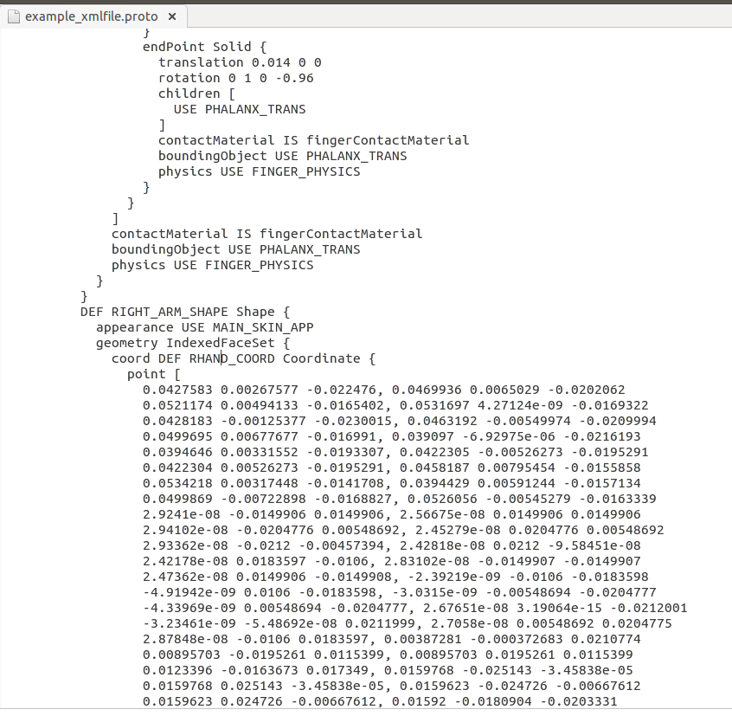
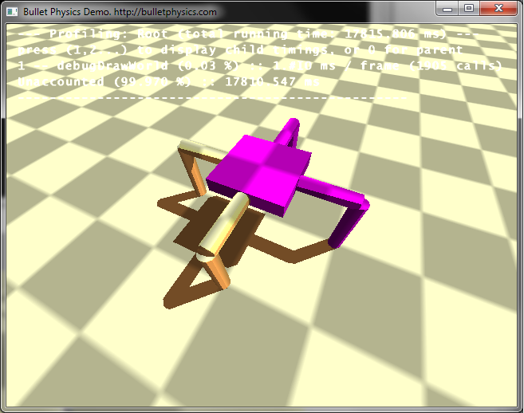
Software
Ludobots
Webots
difficult to customise - only few body part types
impossible to evolve the body
morphology was specified in XML files

Slide 5
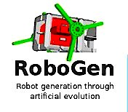
Robogen
developed by J. Auerbach, D. Aydin, A. Maesani, P. Kornatowski, T. Cieslewski, G. Heitz, P. Fernando, I. Loshchilov, L. Daler and D. Floreano.
two core components
evolution engine
simulator

Slide 6
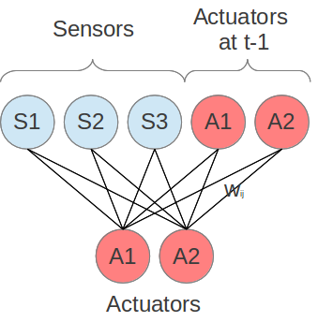
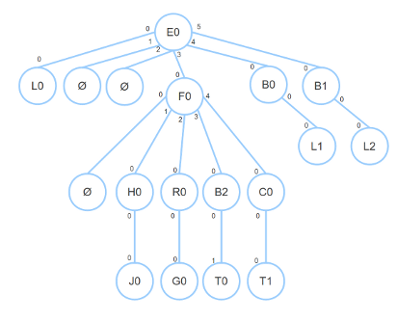
Robogen
controller - fully connected recurrent neural network
body- represented by a tree diagram

Slide 7
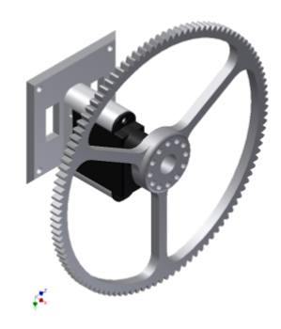
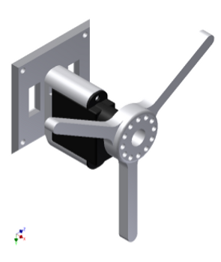
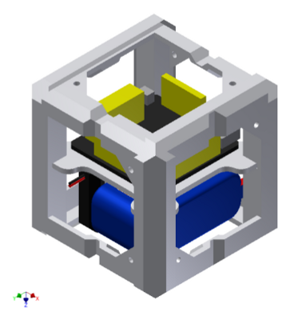
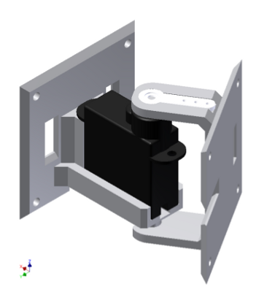
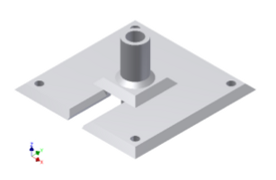
Body parts
wheels
whegs
core module
joints
light sensors
touch sensors

Slide 8
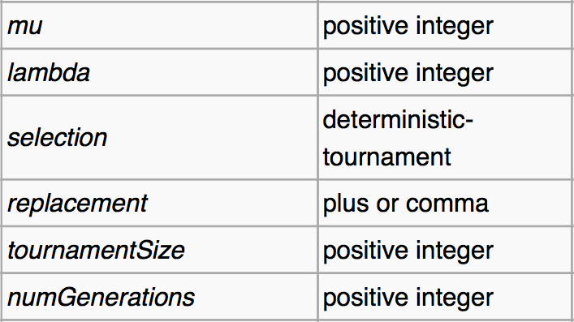
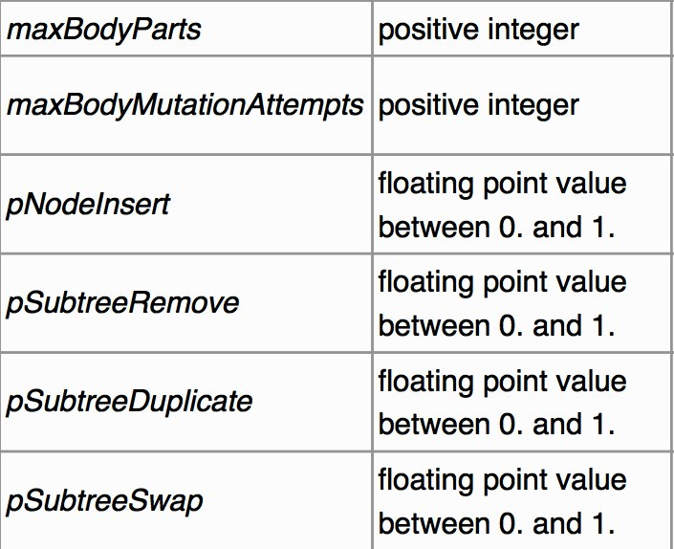
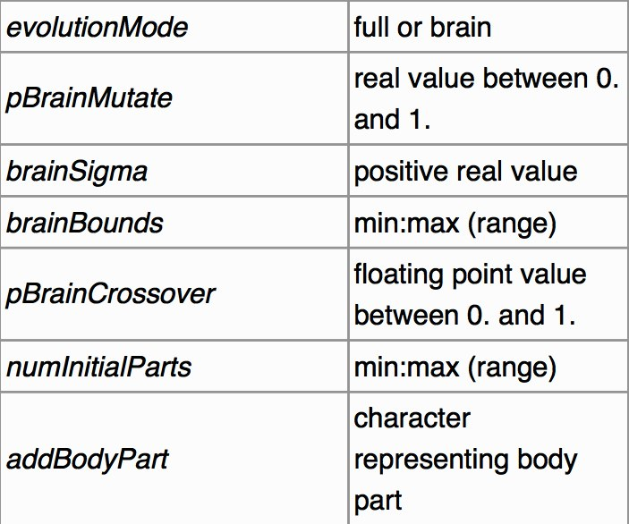
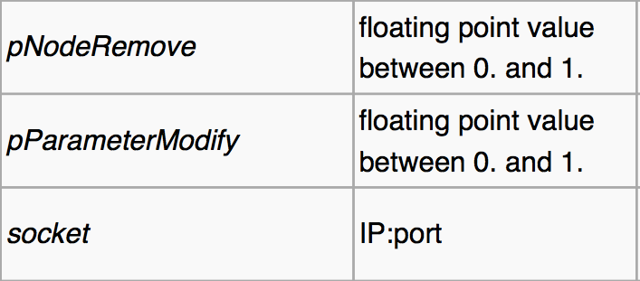
Parameters evolution

Slide 9
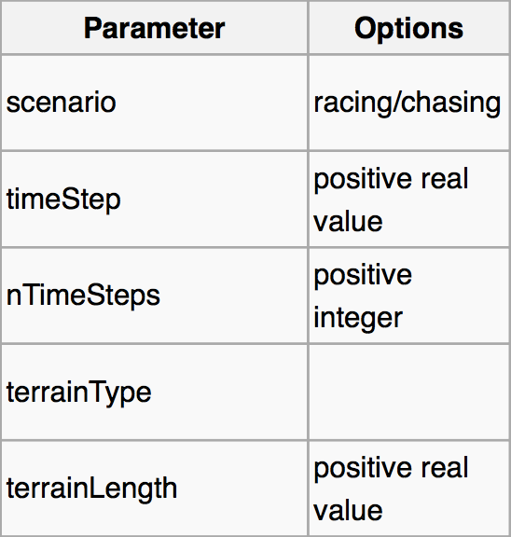
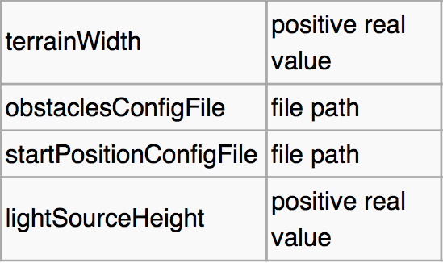
Parameters simulator

Slide 10
Brain evolution
Different morphologies created by hand
Different starting positions
Different brain mutation rates

Slide 11
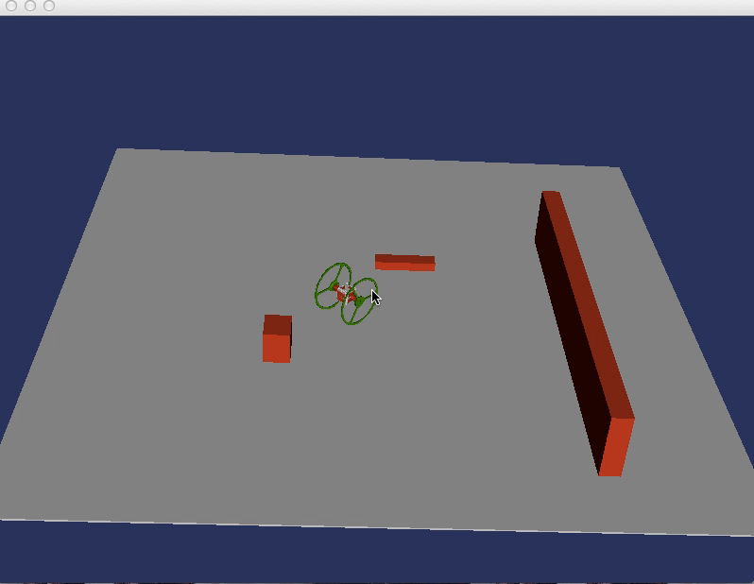
Brain evolution
- racing scenario-

Slide 12
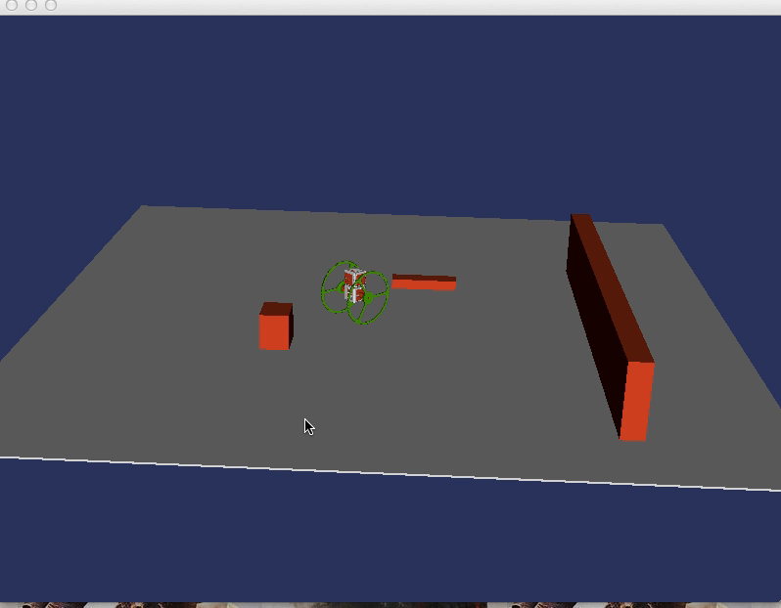
Brain evolution
- racing scenario-

Slide 13
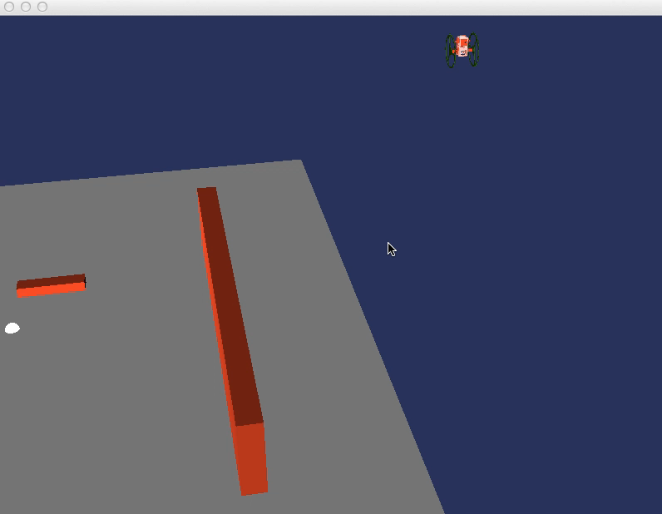
Brain evolution
- chasing scenario-

Slide 14
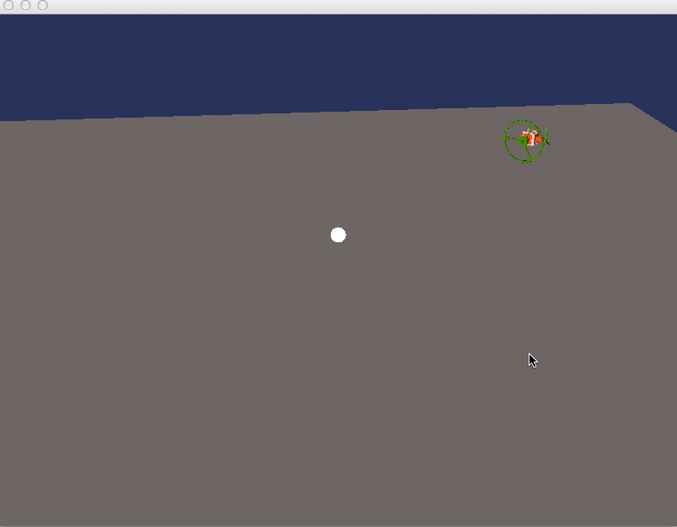
Brain-body coevolution
- chasing scenario-

Slide 15
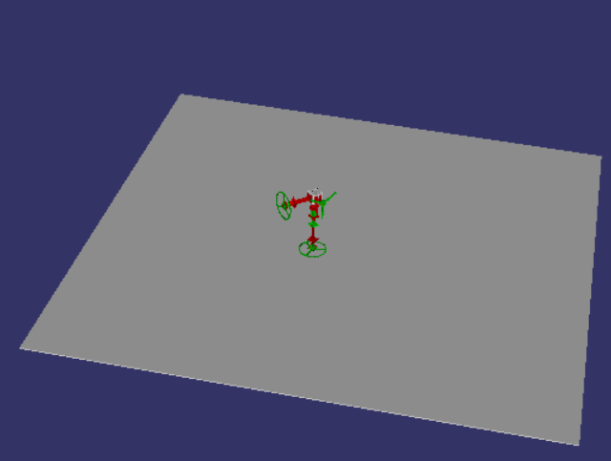
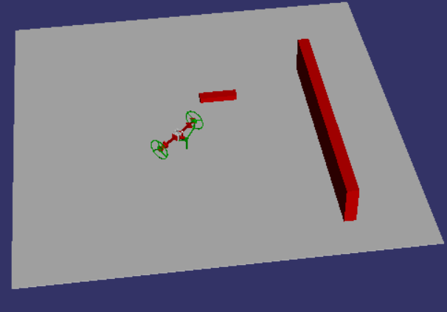
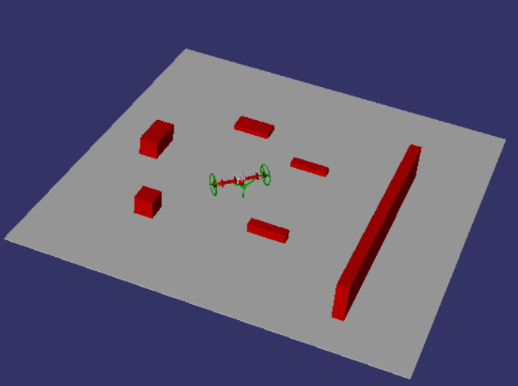
Brain-body coevolution
- racing scenario-
Random initial robot morphology
Three different environments:
Plain surface Low obstacle density High obstacle density

Slide 16
Brain-body coevolution
- racing scenario-
The best results were obtained in the low obstacle density environment.
Increasing the number of iterations usually means getting better results, unless evolution reaches a suboptimal steady state (e.g. the robot falls on its head)

Slide 17
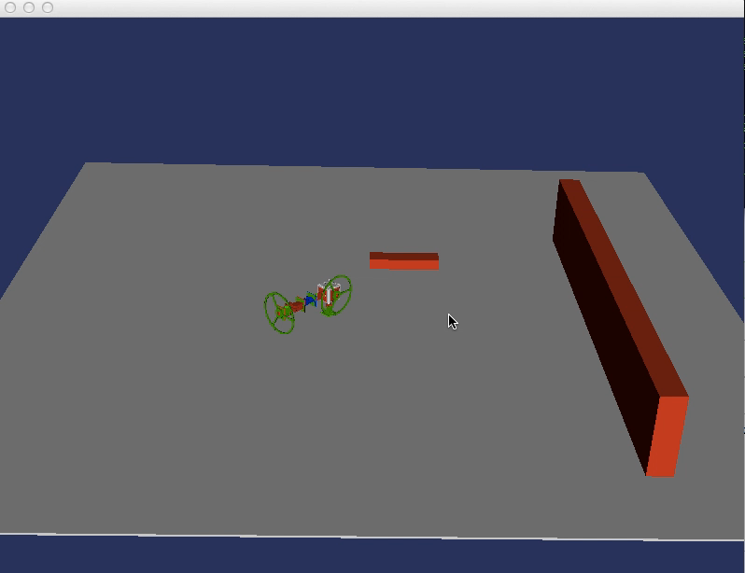
Brain-body coevolution
- racing scenario-

Slide 18
Conclusion
We evolved 2 types of robots - only body, body and brain
We explored different parameters - scenario, brain mutation rate
Most robots are primitive - body evolution is hard
Exploring the parameters is time-consuming
Solution :
design complex bodies by hand and evolve the controller
evolve the brain for simple bodies
limit the body parts used for evolving the body

Slide 19
Thank you!

Slide 20
References
http://imgur.com/ZgaBuu7,Xq2dUtm,Z9Ykkg1,q5MmWAO#3
RoboGen: Robot Generation through Artificial Evolution. J. Auerbach, D. Aydin, A. Maesani, P. Kornatowski, T. Cieslewski, G. Heitz, P. Fernando, I. Loshchilov, L. Daler and D. Floreano. Artificial Life 14: International Conference on the Synthesis and Simulation of Living Systems, New York, NY, USA, July 30-August 2, 2014.

